Slide 1
Docker + K8s Introduction

Slide 2
Before going to Docker + K8s…
Need to go back and understand why this solutions exists
What problems we had before?
What are we trying to solve?

Slide 3
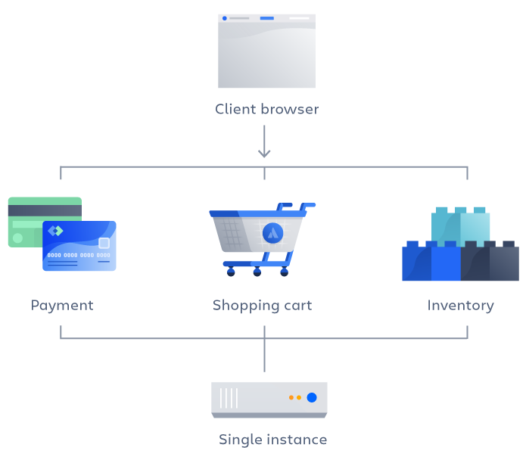
Monolithic Applications
Single and large application [5]
All intelligence is inside
Everything is released at once
Faster development because of the simplicity
Place Graphic Here

Slide 4
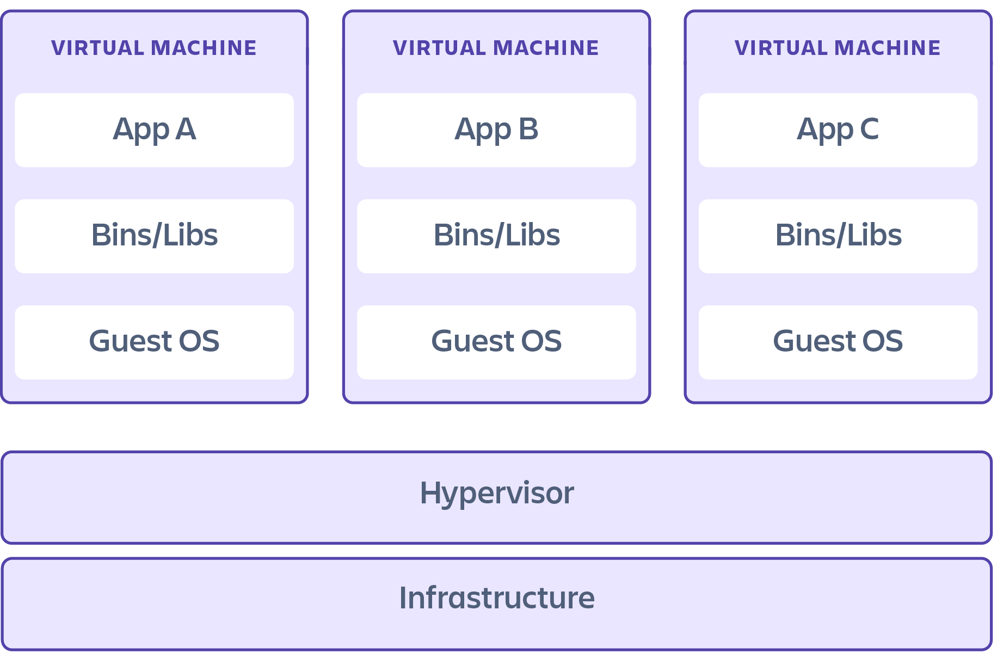
Monolithic Applications
Normally used in Virtual Machines (VMs)
Virtualize an entire machine [2]
Complete emulation of low level hardware, like CPU and Disk [2]
Normally many services run inside one VM [1]

Slide 5
Monolithic application - Pros
High performance [5]
Single application, not necessary to communicate with other services
Simplified testing [5]
Easier to test than a distributed solution
Easier debugging [5]
Easier to follow a request since everything is inside one application

Slide 6
Virtual Machines - Pros
Isolation Security [2]
Each VM is isolated to each other, reducing exploits
Interactive development [2]
Can be treated as a normal computer
Manual installation of software
Snapshot functionality

Slide 7
Monolithic application - Cons
Harder to scale individual components [5]
Most of the cases, only a few parts needs to scale [6]
Long redeployments [5]
Changing small stuff requires redeploying the whole system
Adding or improving features becomes more complex as the base code grows [7]
It also prevents experimentation and new ideas

Slide 8
VMs - Cons
Normally, multiple applications aren’t separated in different VMs [1]
Decrease prices, but do not isolate applications
Full abstraction of a machine [1, 2]
Resource heavy
Possibility of manual configuration [1]
Error prone, even with available documentation
Increased storage usage [2]
Time consuming on upgrades [3]

Slide 9
How can we solve both the VMs and the Monolithic Application shortcomings?

Slide 10
VMs shortcomings – Cloud Native
Many advantages when compared to the traditional approach [4]
Speed, safety and scalability
Continuous delivery with zero downtime
More freedom when choosing technologies to be used
Application isolation [1]

Slide 11
VMs shortcomings – Cloud Native
To have all those advantages, the application must be cloud native [4]
The application must be divided in components, that must be discrete and reusable components [1]
Microservices
Each application is isolated from each other [1]
Containers
Dynamically managed and scheduled by an Orchestration Process [1]
Kubernetes

Slide 12
VMs shortcomings – Cloud Native
To have all those advantages, the application must be cloud native [4]
The application must be divided in components, that must be discrete and reusable components [1]
Microservices
Each application is isolated from each other [1]
Containers
Dynamically managed and scheduled by an Orchestration Process [1]
Kubernetes

Slide 13
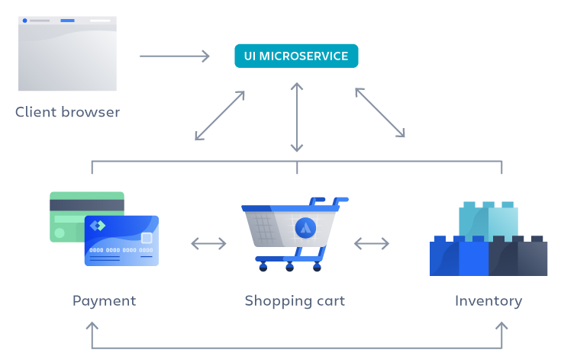
Monolithic shortcomings - Microservices
Separation of one service into multiple independent components [7]
Each component can be updated and deployed without affecting others [5]
More flexibility when choosing technologies to be used [5]
Scaling can be done only in parts that matter [5]

Slide 14
VMs shortcomings – Cloud Native
To have all those advantages, the application must be cloud native [4]
The application must be divided in components, that must be discrete and reusable components [1]
Microservices
Each application is isolated from each other [1]
Containers
Dynamically managed and scheduled by an Orchestration Process [1]
Kubernetes

Slide 15
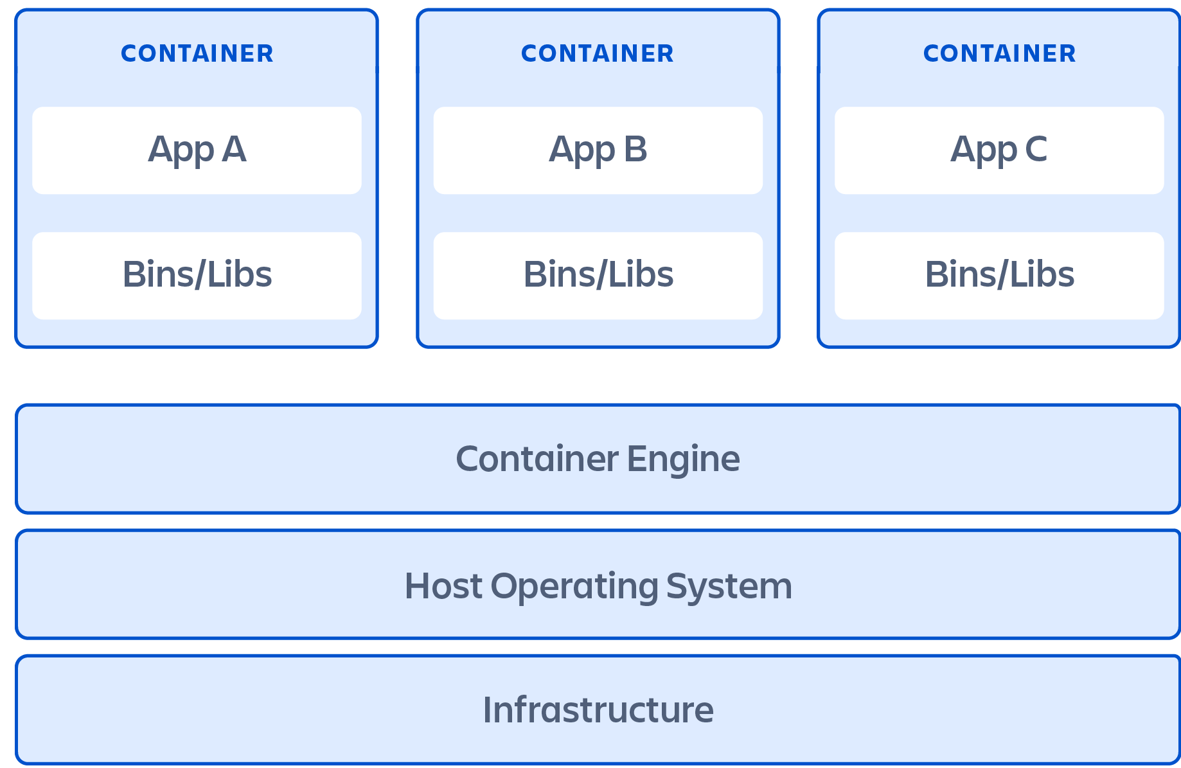
Containers
Runs applications using the same host OS [3]
Build on top of the host’s OS Kernel
Contains only the apps and OS APIs necessary to run [3]
Less resource usage [2]
Enforces progamatically configuration [1]

Slide 16
Containers
Containers are running an instance of an image [1]
Image is created from a build and is immutable
Multiple containers may run from a single image
Different processes, but their starting point is the same
Images can be built using Docker with a Dockerfile

Slide 17
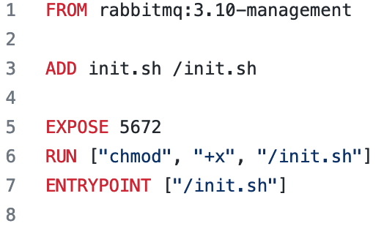
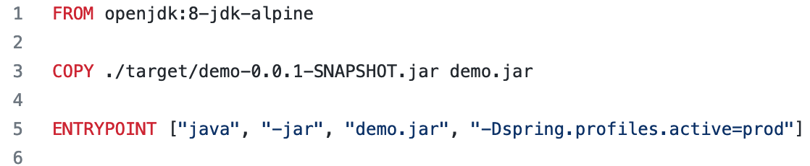
Dockerfile
From a RabbitMQ image
Add the .sh file to inside the image
Expose the port 5672 to be accessible outside
Run an .sh file
From the JDK 1.8
Copy the .jar file to inside the image
Run the file

Slide 18
Docker
To build an image
docker build DOCKERFILE_LOCATION
To push/pull an image
docker pull/push NAME
To run a container with a certain image
docker run NAME
To stop a container
docker stop NAME

Slide 19
Container Registry
Central location for container images [1]
Both public and private are available
Public: docker hub
Private: Harbor
Images are built on host, and can be pushed to the registry [1]

Slide 20
Docker examples….

Slide 21
VMs shortcomings – Cloud Native
To have all those advantages, the application must be cloud native [4]
The application must be divided in components, that must be discrete and reusable components [1]
Microservices
Each application is isolated from each other [1]
Containers
Dynamically managed and scheduled by an Orchestration Process [1]
Kubernetes

Slide 22
Kubernetes
Container orchestration platform [4]
Automating scheduling, deployment and scaling of containerized applications
Works as a declarative way [1]
Defines state, instead of defining actions
The system will decide what to do
To talk to Kubernetes, kubectl command
Files used by Kubernetes are .yaml

Slide 23
Kubernetes
Pods [1]
Contains at least one container (usually one)
All containers in the same pod can talk to each other (localhost) and share the same volume resources (like USB drives)
Reminds of a VMs with many applications
Multiple containers can be used for separation of concerns inside a pod
Services [1]
Load balancing for pods
Traffic is received by the service, which will route to the pods
Which port the service must listen to
Which port the service will send the traffic to

Slide 24
Kubernetes
Deployments [1]
Creating or destroying pods for us
Control how many replicas of a pod will exist to receive traffic
Which strategy will use when updating the container image to a new version
Readiness Probe
Test the pod to check if it can receive traffic
Liveness Probe
Test the pods to check if the pod needs to be restarted (restart all containers inside)

Slide 25
Kubernetes – kubectl
kubectl VERB OBJECT OBJECT_NAME
VERB
get, apply, describe, delete, logs, edit, exec
OBJECT
pod, service, deployment, netpol, job, namespace
kubectl get pods
kubectl describe servisse service_name
kubectl exec –it pod_name /bin/sh
kubectl logs –f pod_name

Slide 26
Kubernetes examples….

Slide 27
Kubernetes - Connections
Inside a pod (container to container)
Connection via localhost
Pod to pod
Each pod can communicate to another inside the cluster
Via IP or DNS
Service to pod
ClusterIP: only accessible inside the cluster
NodePort: accessible from outside the cluster, need to set a port for this
LoadBalancer: Utilizes an external load balancing strategy

Slide 28
Kubernetes - Connections
Every time a pod is created, a new IP is generated
Not recommended
DNS is available inside the cluster
SERVICE.NAMESPACE.CLUSTER
test-service.test-namespace.svc.cluster.local
kafka-service.kafka-namespace.svc.cluster.local

Slide 29
Kubernetes – Volumes
If you delete a pod, any data the containers created will be deleted together
Volumes can be used to attach a storage to the pod
Lifecycle independent from the pod

Slide 30
Kubernetes – Jobs
Services inside thew Kubernetes are constantly running
Jobs normally start and finish
Resources will remain, like logs
Types:
Job
Run one, then exit
Can be parallelized
CRON job
Run from time to time

Slide 31
Kubernetes – ConfigMaps
To prevent hardcoded stuff like addresses or passwords
ConfigMaps
Configurable in runtime
Stores a pair of Key and Value
Needs to restart the container to update the values
Secrets
For sensitive information
Stuff are loaded in BASE64

Slide 32
References
[1] https://kube.academy/courses/kubernetes-core-concepts-part-1
[2] https://www.atlassian.com/microservices/cloud-computing/containers-vs-vms
[3] https://learn.microsoft.com/en-us/virtualization/windowscontainers/about/containers-vs-vm
[4] https://cloudnative101.dev/
[5] https://www.atlassian.com/microservices/microservices-architecture/microservices-vs-monolith
[6] https://learn.microsoft.com/en-us/dotnet/architecture/containerized-lifecycle/design-develop-containerized-apps/monolithic-applications
[7] https://aws.amazon.com/microservices/

Slide 33


